Slide 1
JSPM’s
RAJARSHI SHAHU COLLEGE OF ENGINEERING
TATHAWADE, PUNE-33
COMPUTER ENGINEERING DEPARTMENT
BE Computer Engineering
Project Presentation
2021-22
Semester-II

Slide 2
Crop Recommendation System
Guided By
-Prof. A. H. Hingmire
Exam Seat No | Name of Student
T150374226 | Sujit Hingane
T150374219 | Rohan Dhore
T150374210 | Gaurav Bhore
T150374253 | Tushar Pangare

Slide 3
Introduction Weather plays an important role in agriculture production. For optimal productivity crops must be such that their weather requirement match the current weather system. So we need to plan them according to the weather conditions and soil fertility. This is a prototype for a crop recommendation algorithm in Python using Machine Learning and Data Analytics. This work presents a system, in form of a website. The business logic in Python uses Machine Learning techniques in order to predict the most profitable crop in the forecasted weather and soil conditions. The proposed system will provide a suitable crop for particular soil and weather conditions.

Slide 4
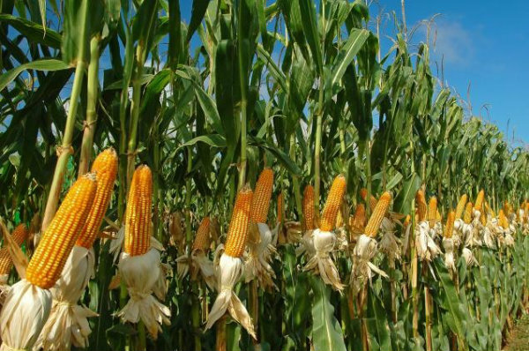
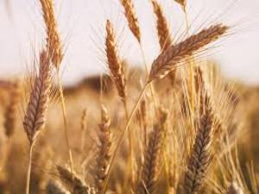
Problem Statement Design a useful tool which recommends the type of crop that should be cultivated based on certain aspects like temperature, humidity, rainfall, etc

Slide 5
Scope
Improving crop productivity
Efficient crop yield
Smart and efficient crop management
Time- saving
Elimination of Human Errors

Slide 6
Literature Survey
Sr.No | Research paper | Date of Issue | Methodology | Results
1 | Crop Recommendation System for Precision Agriculture S.Pudumalar, E.Ramanujam IEEE Eighth International Conference on Advanced Computing (ICoAC) | 2016 | Model: Support Vector Machine, Random Forest, Accuracy: 88% | The prediction accuracy of the model accounts to 88%. Thus the farmer’s can plant the right crop increasing his yield and also increasing the overall productivity of the nation
2 | Recommendation of Crop, Fertilizers and Crop Disease Detection System S.N.Uke | 2018 | Model:RANDOM TREE,NAÏVE BAYES,K-NEAREST NEIGHBOR Accuracy: 83% | Algorithm has an average accuracy of 83% on the given dataset.

Slide 7
Literature Survey
Sr.No | Title | Date of Issue | Methodology Used | Results
3 | Crop Recommendation System to Maximize Crop Yield using MachineLearning Technique D.Anantha Reddy, Bhagyashri Dadore, Aarti Watekar International Journal of Scientific Research in Science and Technology | 2019 | Model:SupportVector machine(SVM), RandomForest, Multi-layer Perceptron (Artificial Neural Network) Accuracy: 87% | Our work would help farmers to increase productivity in agriculture, prevent soil degradation in cultivated land,and reduce chemical use in crop production and efficient use of water resources
4 | Agricultural recommendation system for crop Protection Javier Lacasta, F. Javier Lopez-Pellicer Aragon Institute of Engineering Research (I3A), Universidad de Zaragoza, Spain | 2020 | Model :Decision Tree, SVM Algorithm Accuracy : 85% | Our work would help farmers in sowing the right seed based on soil requirements to increase productivity of the nation. Our future work is aimed at an improved data set with large number of attributes and also implements yield prediction

Slide 8
Literature Survey
No | Title | Date of Issue | Methodology | Result
5 | Recommendation System for Crop Identification and Pest Control Technique in Agriculture Avinash Kumar, Sobhangi Sarkar and Chittaranjan Pradhan IEEE International Conference on Computationof Power | 2019 | Model:Logistic Regression, Decision Tree, SVM Algorithm Accuracy: 89.66% | Our model is designed by using Spyder IDE (ANACONDA 3) and the accuracy of our accounts to 89.66%.
6 | Web Based Recommendation System for Farmers Jerrin Andrei, Amey Oke International Journal on Recent and Innovation Trends in Computing and Communication | 2020 | Model:Random Forest Algorithm,Naive Bayes’ algorithm Accuracy: 86% | The paper proposes the use of data mining techniques to provide recommendations to farmers for crops, crop rotation and identification of appropriate fertilizer

Slide 9
Requirement Analysis
Software Requirement:
Python v3.5
HTML 5
Django v3
CSS v3
Hardware Requirement:
Processor : 64bit , i5 or above
RAM: min 4GB
Windows 10

Slide 10
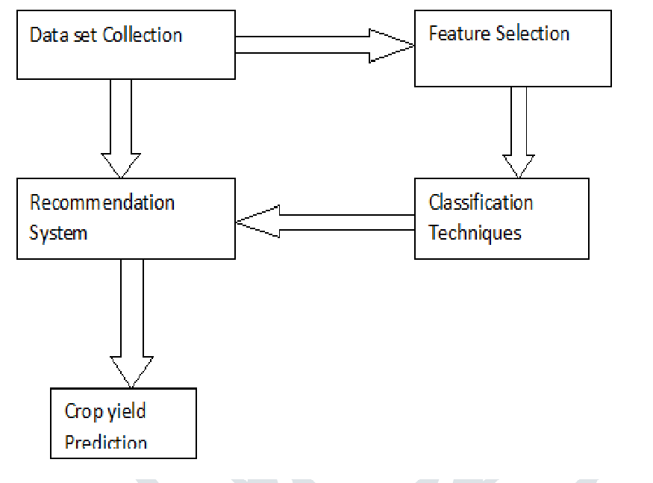
Proposed System

Slide 11
Modules
Module 1: Preprocessing of Data
Module 2 :
Train Model
Module 3: Suggestion of Crop

Slide 12
Description of Modules
Module 1: Preprocessing of Data
Input: Training & Testing Data
Output: Required data for the prediction

Slide 13
Description of Modules
Module 1: Train Model
Input: Different soil attributes
Output: Trained model to predict the crop

Slide 14
Description of Modules
Module 1: Suggestion of Crop
Input: Soil condition attributes from user
Output: Prediction of suitable crop to grow in farm

Slide 15

Algorithm
Available Algorithms: Decision Tree, Naïve Bayes, Random Forest, Logistic Regression.
Used Algorithm: Random Forest

Slide 16
Algorithm
Random Forest Algorithm:
Random Forest is a popular machine learning algorithm that belongs to the supervised learning technique. It can be used for both Classification and Regression problems in ML
Random Forest is a classifier that contains a number of decision trees on various subsets of the given dataset and takes the average to improve the predictive accuracy of that dataset.
Instead of relying on one decision tree, the random forest takes the prediction from each tree and based on the majority votes of predictions, and it predicts the final output.

Slide 17
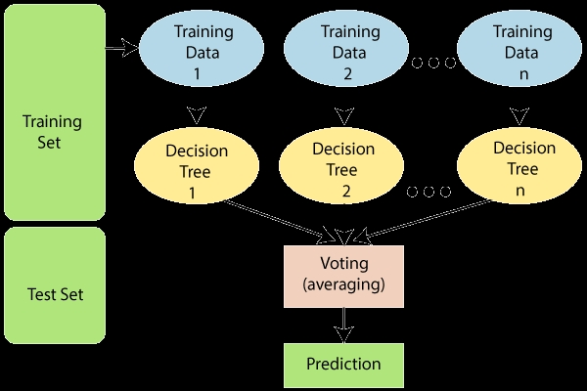
Workflow
The below diagram explains the working of the Random Forest algorithm:

Slide 18
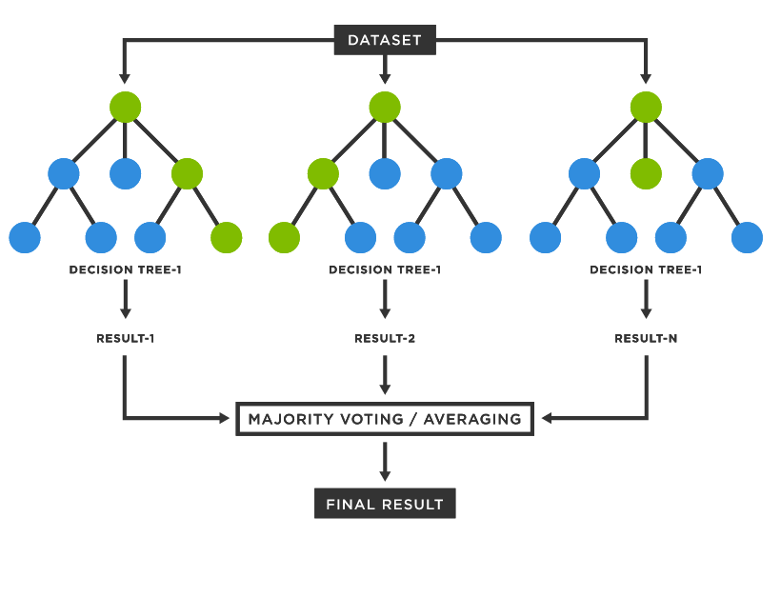
Working of Random Forest

Slide 19
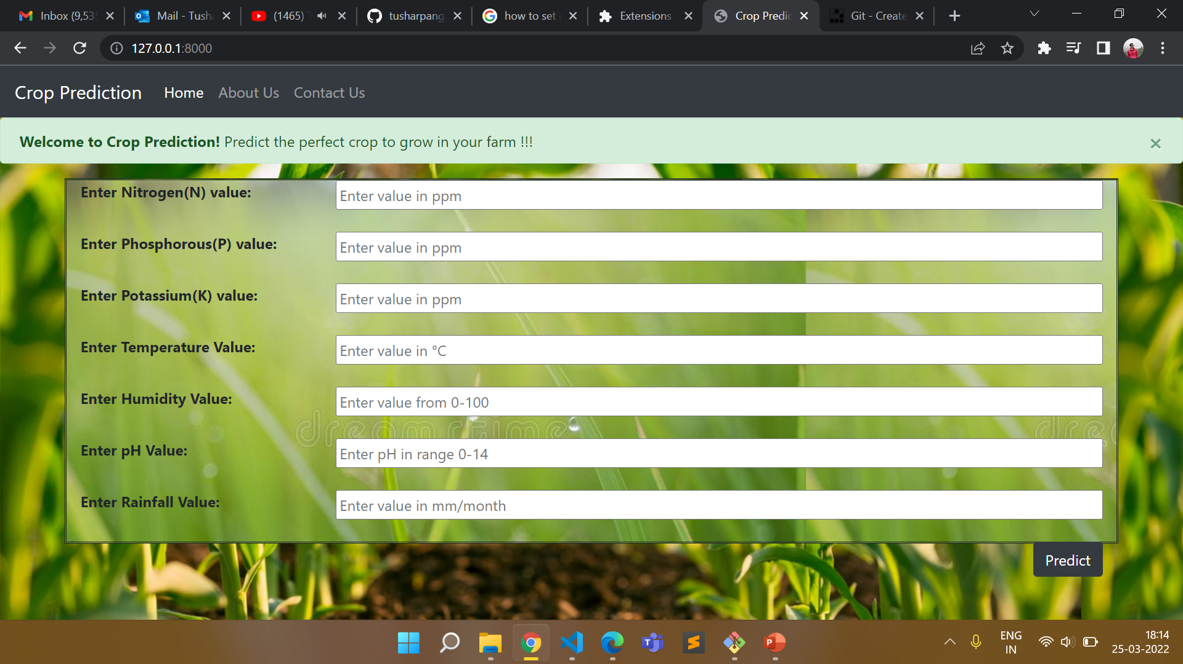
Output screenshot

Slide 20
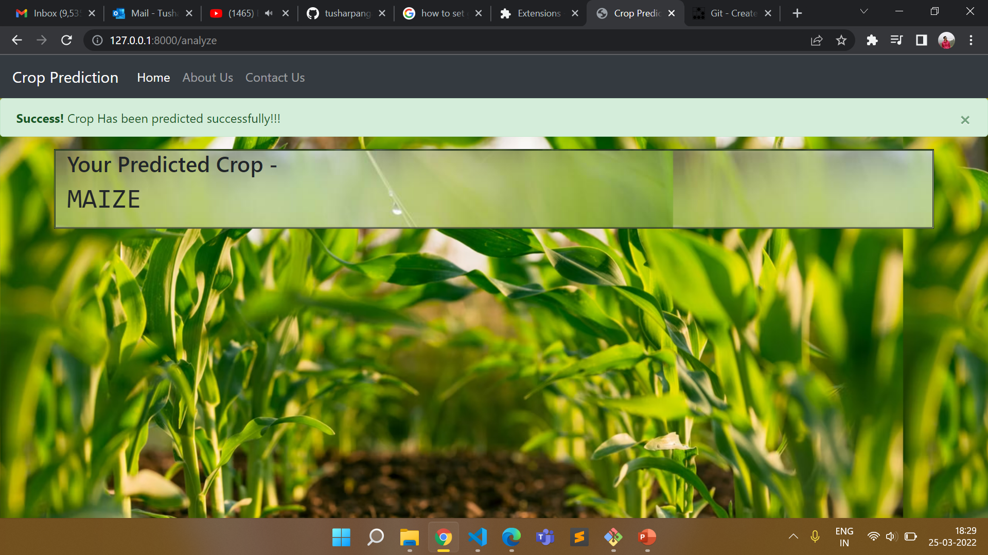
Output Screenshot

Slide 21
Future Scope Automated crop recommendation system has tremendous demand and potential for the future too. It is time-saving, leading to the elimination of human error in adjusting the available levels of soil moisture and optimizing net profits in terms of factors such as market price, product quality and production.

Slide 22
References
Crop Recommender System Using Machine Learning Approach(IEEE) (https://ieeexplore.ieee.org/document/9418351)
Crop Monitoring and Recommendation System using Machine Learning and IOT (Published in (IJITEE)) by-R. Pallavi Reddy, B. Vinitha, K. Rishita, K. Pranavi
Demand Based Crop Recommender System for Farmers (TIAR 2017) by – S. Kanaga Suba Raja (https://www.researchgate.net/publication/322877007_Demand_based_crop_recommender_system_for_farmers)
Crop Recommendation System for Precision Agriculture (2016 IEEE Eighth International Conference on Advanced Computing (ICoAC) ) by- S. Pudumalar , E . Ramanujam,

Slide 23

THANK YOU

